Slide 1
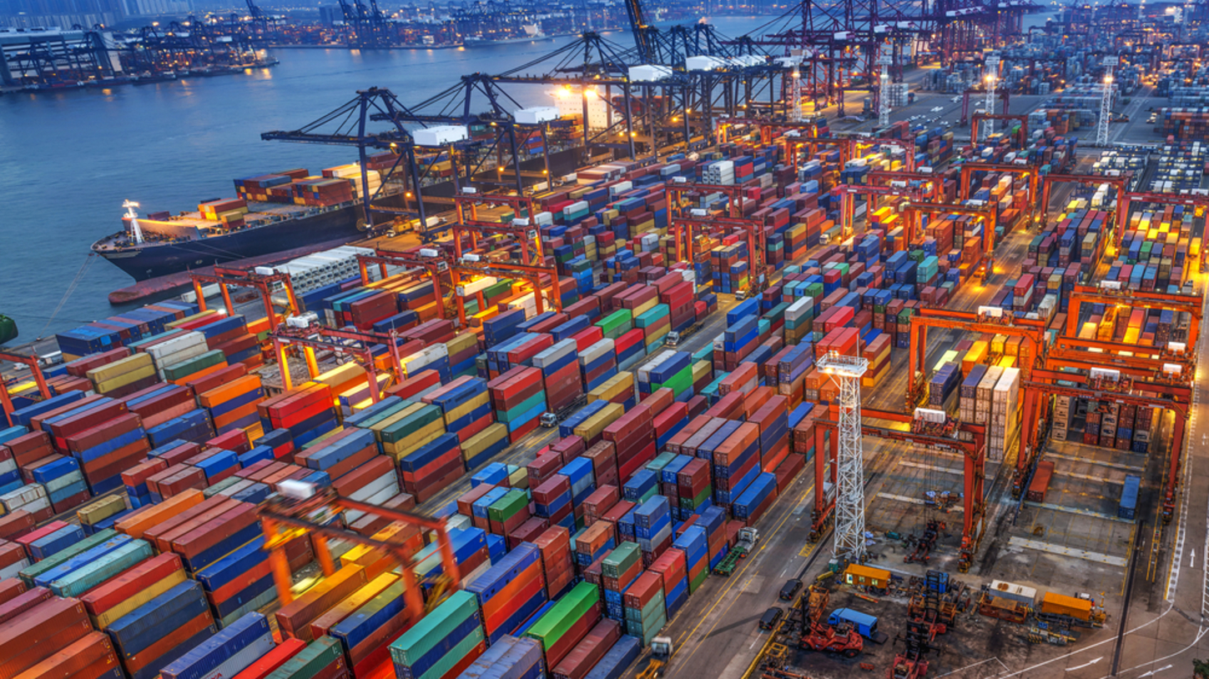
Import and Export of Indian Trade
Capstone project by Vipul pawar
RU ID: 190005669
DR. Mehmet turkoz
This Photo by Unknown Author is licensed under CC BY-ND

Slide 2
Analyzing the nooks and crannies of Indian Foreign Trade
This Photo by Unknown Author is licensed under CC BY-ND

Slide 3


Background for Indian Trade
In 1991 there was an Economic Liberalization in India, which refers to the economic liberalizations of the country's economic policies, initiated to make the economy more market- and service-oriented, and expanding the role of private and foreign investment
Before the 1991 economic liberalization, India was a closed economy due to the average tariffs exceeding 200 percent and the extensive quantitative restrictions on imports
Foreign investment was strictly restricted to only allow Indian ownership of businesses. Since the liberalization, India's economy has improved mainly due to increased international trade

Slide 4
Stats on Indian Trade
Foreign trade accounted for 48.8% of India's GDP in 2017
India exports approximately 7500 commodities to about 190 countries, and imports around 6000 products from 140 countries
India exported US$318.2 billion and imported $462.9 billion worth of commodities in 2014
India's largest trading partners in descending order of value of total trade are the UAE, China, United States, Saudi Arabia, Switzerland, Singapore, Germany, Hong Kong, Indonesia, Iraq, Russia and Japan

Slide 5

About the Data
This dataset includes the commerce data for India for commodities in the HS2 basket
Consisting of trade values for export and import of commodities in million US$
The recorded data is within the timeline of 8 years from 2010 to 2018
It consist of variables HSCode, Commodity, value, country and year

Slide 6
Data Preprocessing
The analysis is done using Python, executed in Spyder IDE within a Windows Platform
Firstly and foremost we import Python libraries like numpy, pandas, matplotlib, seaborn, squarify, and plotly
Basically used for algebra, processing, charts, graphs, and figures like Treemaps
We import the data into our Spyder IDE. Assigning the import data and export data to data_import and data_export variables, respectively

Slide 7

Data Preprocessing
Variable value contains Null Values for both the datasets
Value also contains some zero records
The country column has a few undefined values
The dataset has some duplicate records
We deal with these peculiarities by eliminating them

Slide 8

Descriptive Statistics
HSCode for both the sets indicates that data is under 1 to 99
The value column in Import and Export data shows a considerable outlier as 75 % data is below 3.7 and 4.9, and the maximum is 19805, and 32781 respectively seems some items category are costly. Also, min is zero as some export maybe two small to roundoff in two decimals
Export files have 137023 rows of data
Import files around have 67799 rows of data

Slide 9
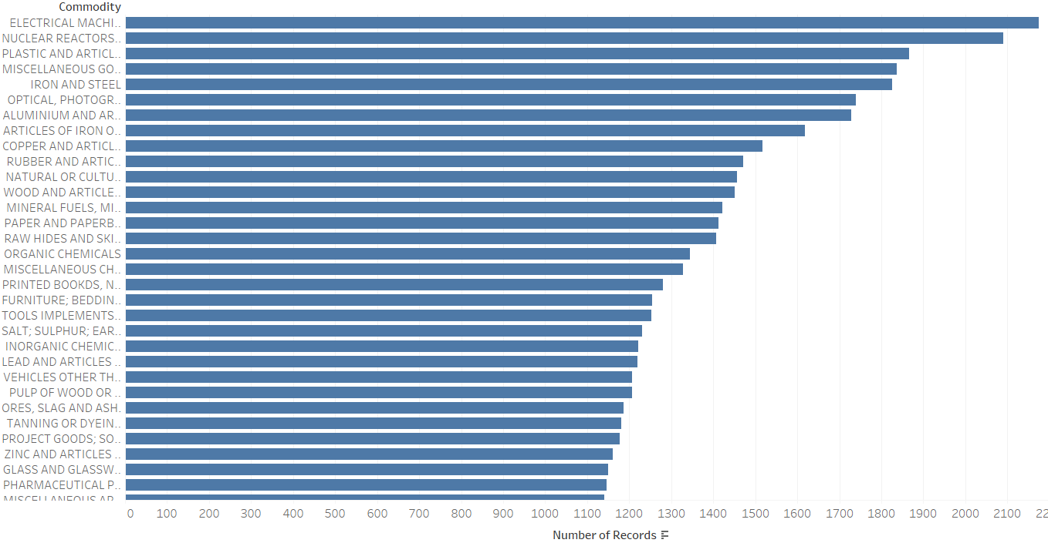
Analyzing Imports
Registering 98 commodities during the import transactions
Figure depicts the most popular imported commodities within India based on their quantities
Top 3 being Electrical Machinery, Nuclear Reactors and Plastic and similar articles

Slide 10
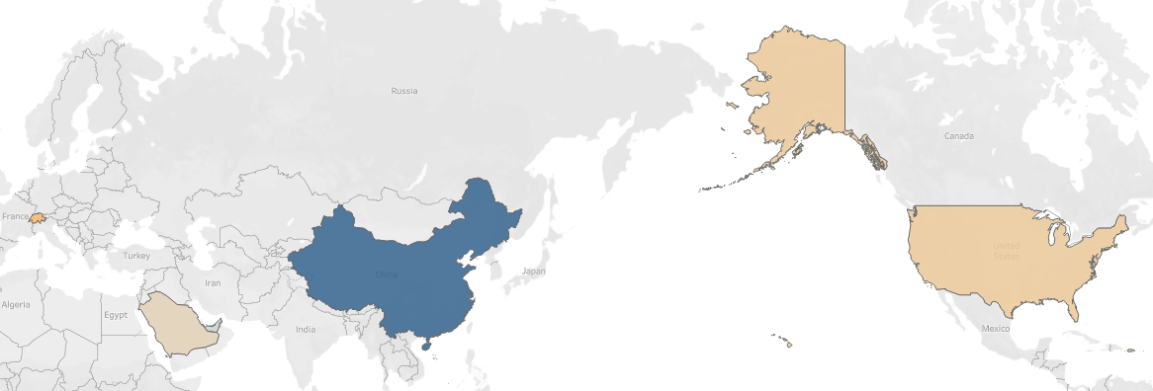
Analyzing Imports
According to the data India imported from 240 countries
As seen in the figure, the 5 biggest importers in India are UAE, China Republic, USA, Saudi Arab, and Switzerland
As per the data, China has the largest market in India

Slide 11
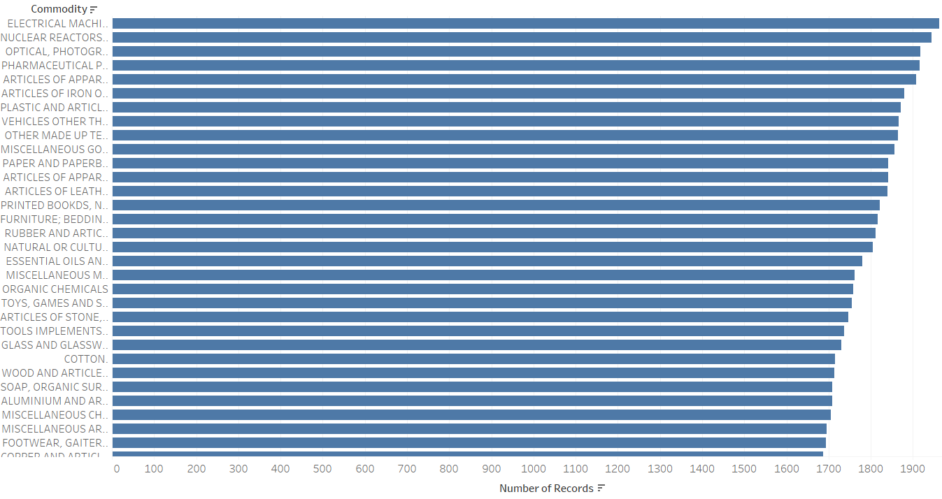
Analyzing Exports
India exported 98 types of goods to different countries according to the set
The figure depicts the most popular imported commodities within India based on their quantities.
Top 3 being Electrical Machinery, Nuclear Reactors and Optical, photographic and Cinematography measuring

Slide 12
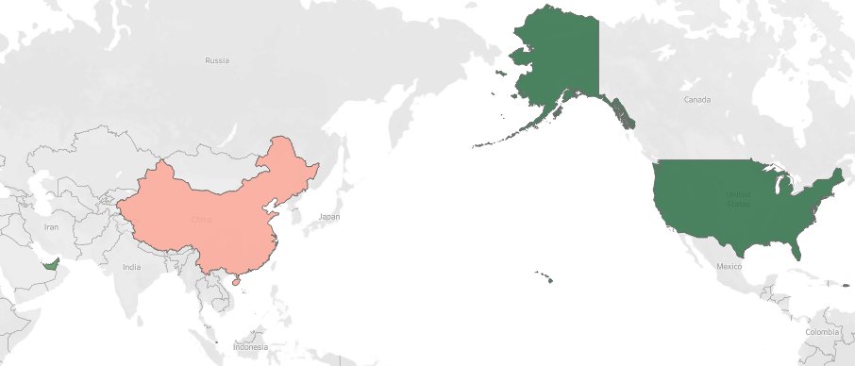
Analyzing Exports
According to the data India exports to 245 countries
As observed in the second pattern, the countries that India exports the most goods are UAE, China Republic, USA, Hong Kong, and Singapore.
The USA is the biggest importer of Indian commodities.

Slide 13
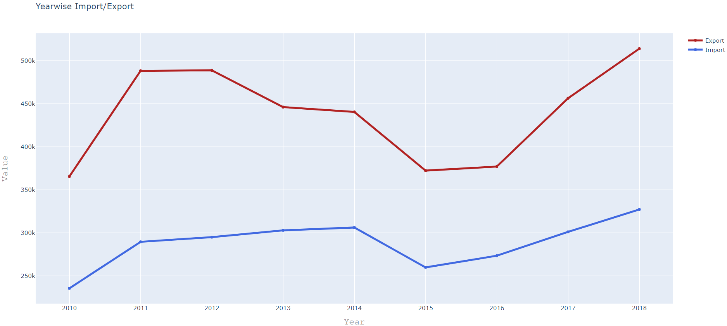
Comparative interpretation of Indian Export and Import trend from 2010 till the year 2018
Right out of the bat the 2 most noticeable trends were a notable increase in the Foreign trading back in 2010 through 2011and a drop in trade between the years 2014 - 2015.
In 2016 and 2013, it shows Indian commodities that were shipped out were steady or decreasing, but the import was growing.
Export shows a descending trend after 2011-2012 till 2016, after which the export increased again.
Import showing an upward trend of 2010 - 2011 then till 2014 shows a sideways trend then a sharp decline in 2015 and an upward trend after that.

Slide 14
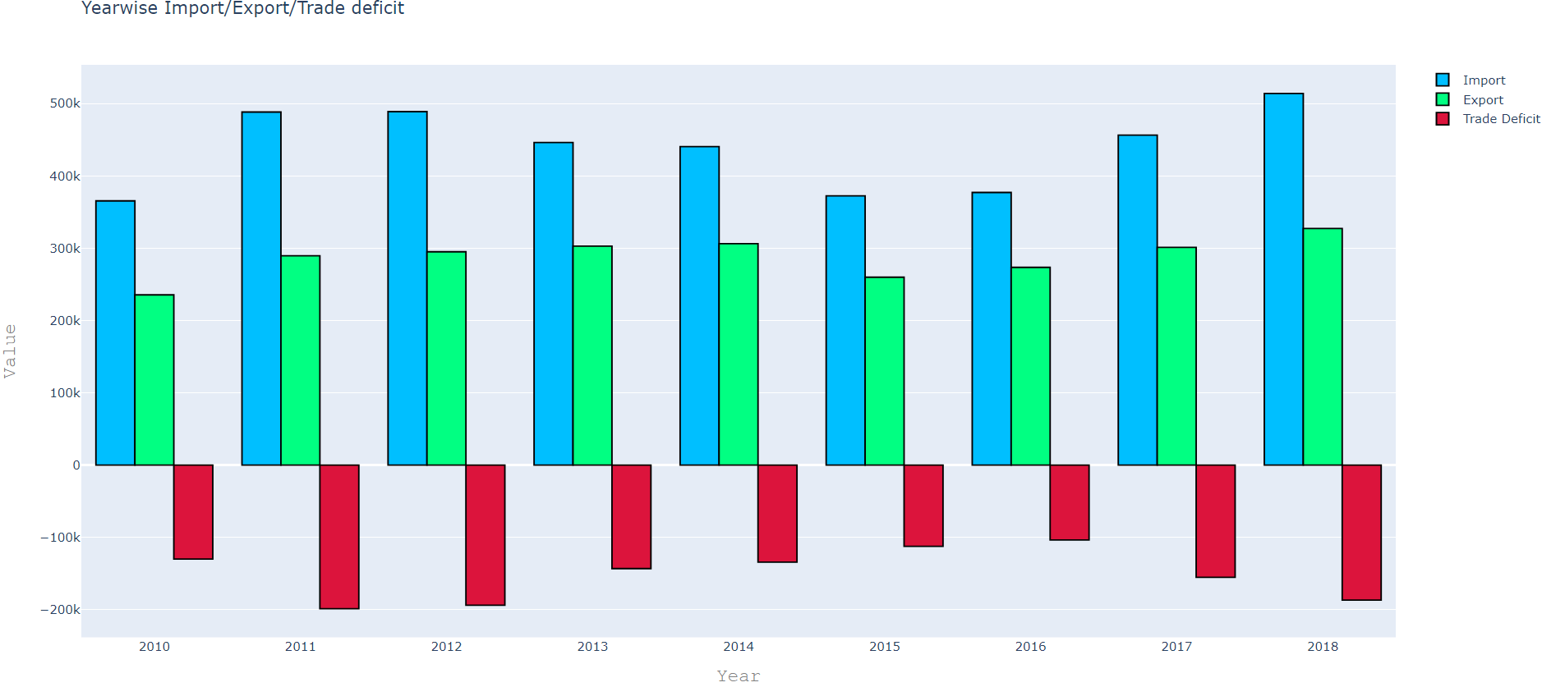
Trade Deficit
Definition-The amount by which the cost of a country's imports exceeds the value of its exports.
Import is always more than export creating a trade deficit, which we can see in the red bar graph
2011,2012 shows a substantial colossal trade deficit and after which it gradually decreases till 2016, and then it grew in 2017 and 2018

Slide 15
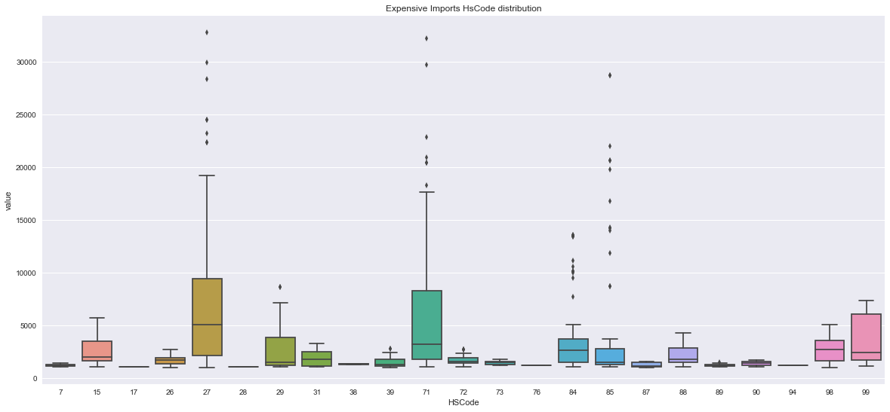
Tackling the Issue
A hard look at elements driving the deficit
We try to single out the expensive imports
Ploting a box plot of HSCode and value w.r.t. expensive import
We see significant outliers pertaining to the codes 27, 71, 84, 85.

Slide 16
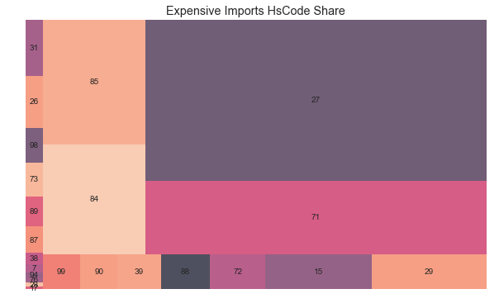
Tackling the Issue
Visual representation of the TreeMap between HsCode VS Expensive Imports
This further bolsters our analysis about the codes
Indicating 27, 71, 85, 84 could be the proponents playing major role in the Indian trade deficit
Them being mineral fuels and oils, precious metals, electrical machinery and equipment, and lastly nuclear reactor and their parts

Slide 17
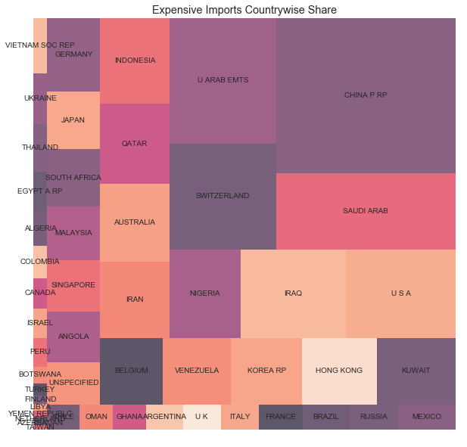
Tackling the issue
Lastly we look at the countries associated we these expensive imports
We discover them to be China, Saudi Arabia, United Arab Emirates and Switzerland being at the top
Top Commodity associated with the above countries:
China – Electrical Machinery
United Arab Emirates – Precious Stones
Saudi Arabia - Mineral Oils and Fuel
Switzerland – Precious Stones

Slide 18

Suggestions
Specifically targeting India's major import partners from which India imports the most prized commodities. By building relations and establishing a bilateral trade would help subsidize the products in good faith.
Another effective way would be depreciating the exchange rate since a weaker currency would result in expensive imports and exports cheaper and improves the trade balance.
India could start taxing the capital inflow, which in turn would make it harder and more expensive to borrow from aboard. As one of the reasons for a trade deficit is borrowing from abroad is cheap and easy.
A taxon capital inflows that rise with the size of the inflow could reduce excessive borrowing for consumption and help close the government imbalance. Introducing more policies like Make in India Movement, which encouraged companies to manufacture their products in India and enthuse with dedicated investments into manufacturing.

Slide 19

Conclusion
India is the world's fifth-largest economy by nominal GDP and the third-largest by purchasing power parity
India was the world's fastest growing major economy, surpassing China
India is also ranked 3rd among countries and territories with the largest deficit in current account balance as listed in CIA WORLD FACTBOOK
But for India to grow further, it needs to improve its foreign trade.

Slide 20






